Slide 1
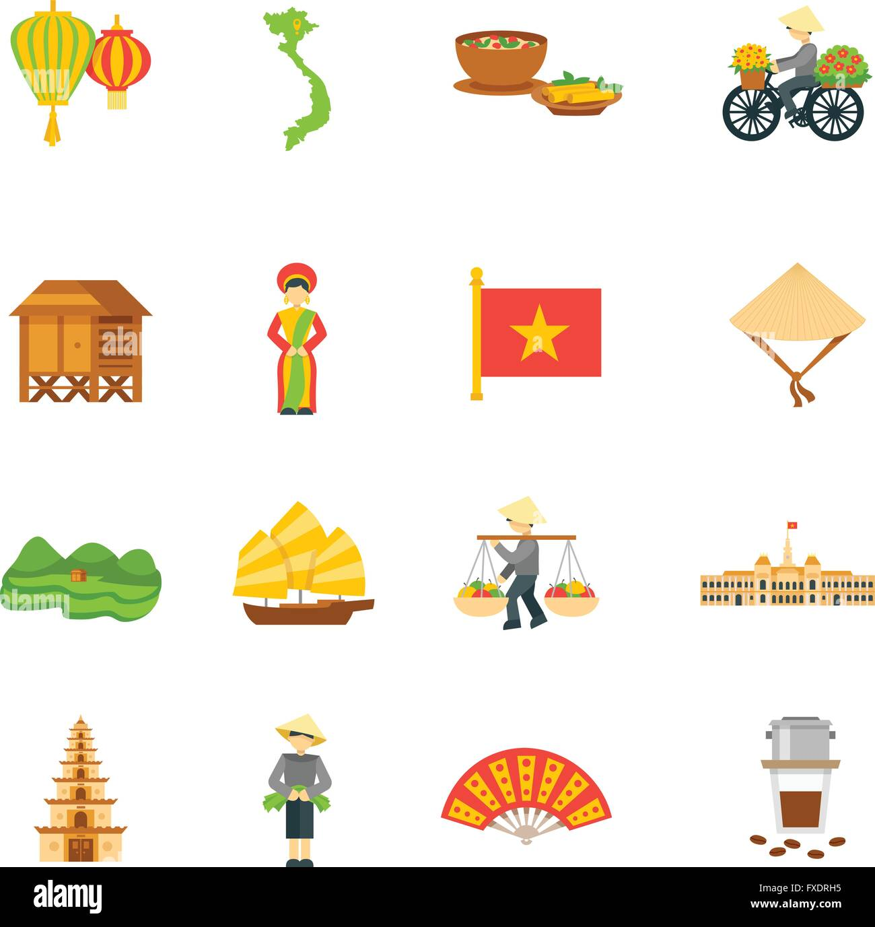
Lesson 1

Slide 2

Objectives
Get to know Vietnamese alphabetical characters and the tone/marking system.
Learn how to pronounce four single letters: e, b, ê, v and how to combine words from these letters with tones/markings.
Learn how to pronounce these words correctly.
Practice reading few simple sentences.

Slide 3

Lesson 1 Section 1

Slide 4
1. The alphabet
print
Letters are written in two forms: print and cursive forms. All the lessons in this website only use the print type because most reading texts are in this kind of writing.
You are not required to memorize all the letters and their pronunciations.
cursive
Figure 1. Vietnamese alphabet

Slide 5


1. The alphabet
Click on the sound icon, listen carefully and repeat.
Click on the question mark icon for my guiding question!
Questions: 1) What letters are new to you or what letters are not English? 2) What English letters do not exist in this alphabet? 3) What letters are difficult to pronounce? 4) What letters have similar or same sound?

Slide 6

2. Letters: e, b, ê, v
Click on the sound icon, listen carefully and repeat.
Letter | Pronunciation tips
e (vowel) | ‘e’ (/e/) as in “bed” or “lend”
ê (vowel) | ‘ai’ (/ei/) as in “gain” or “wait”
b (consonant) | ‘b’ (/b/) as in “big” or “bomb”
v (consonant) | ‘v’ (/v/) as in “victory” or “van”

Slide 7
Can you identify the similarity and difference in the sounds of “e” and “ê”?
To pronounce both these two letters, your tongue is being pulled forward to reach your lower jaw front teeth. To pronounce “e”, your mouth shape is flat like you are smiling. This letter is pretty easy to sound because it’s as same as in English. To pronounce “ê”, your mouth shape needs to be much rounder.
!
Now listen again, repeat and REMEMBER their pronunciation.
Letter | Pronunciation tips
e (vowel) | ‘e’ (/e/) as in “bed” or “lend”
ê (vowel) | ‘ai’ (/ei/) as in “gain” or “wait”
b (consonant) | ‘b’ (/b/) as in “big” or “bomb”
v (consonant) | ‘v’ (/v/) as in “victory” or “van”

Slide 8

Lesson 1 Section 2

Slide 9
3. Words constructed from e, b, ê, v
Use the formula: 1C+1V (1 consonant + 1 vowel) to create words from the 4 letters you have learned in the last section.
Questions: How many words can you create? Can you predict what these words may sound?
Hint: Click on the question mark icon for the answers.
Consonant Vowel | e | ê
b | be | bê
v | ve | vê
Click on the sound icon for the word pronunciation!
Wait! It seems pretty easy, right?...Well, actually, there are 24 possible “words” could be built! Let’s find out!

Slide 10





To construct a total of 24 “words”, you need to learn the tone/marking system in Vietnamese. This is your very first challenge! Fighting!
3.1. Tones/Markings

Slide 11
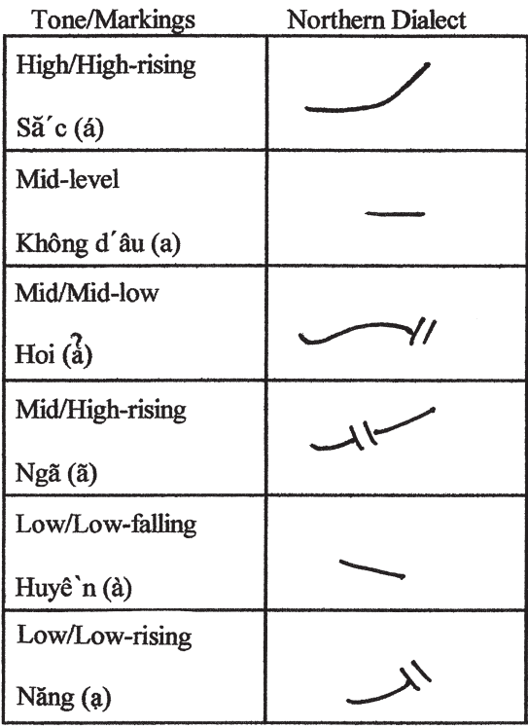
How it’s marked | Vietnamese name | English name | How to say its name | Pitch characteristic | How sound looks like
sắc (Acute-angry or breathing rising)
huyền (Grave-lowering)
nặng (Chesty-heavy)
ngang (Level)
hỏi (Smooth rising)
ngã (Chesty-raised)
6 tones
or
markings
Position: over/under a vowel
Figure 2. Tonal differences

Slide 12


Challenge: Memorize all the Vietnamese names of 6 tones and what they look like!
sắc
huyền
nặng
ngang
hỏi
ngã
Tips: listen to how I say the names of the tones, repeat, record your pronunciation and correct yourself. If you need help, ask me via email or in the “Learning Buddies” section.
Let’s do a mini test!
Click Start to begin the test or Later to continue the Lesson!
Start
Later

Slide 13
Test yourself
https://forms.office.com/r/tXADN7Nz98

Slide 14

Lesson 1 Section 3
Image source: https://www.nguoiduatin.vn/ngam-hoa-dao-ruc-ro-khoe-sac-tren-duong-pho-ha-noi-nhung-ngay-giap-tet-a417397.html​

Slide 15
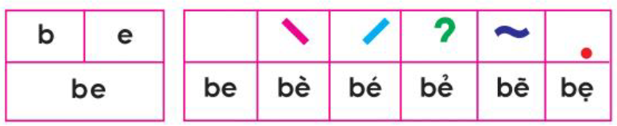
Let’s start mixing letters to create words and learn their pronunciation!
3.2. Words creation and their pronunciation

Slide 16
1. Pronouce the consonant
2. Pronounce the vowel
3. Pronounce the combination
5. Pronounce the tone
Spelling process
4 + 6. Pronounce the complete word
Click on the button to listen! Repeat while you listen.
1
2
5
5
5
5
5
Figure 3. Spelling process.
4
6
6
6
6
6
3

Slide 17
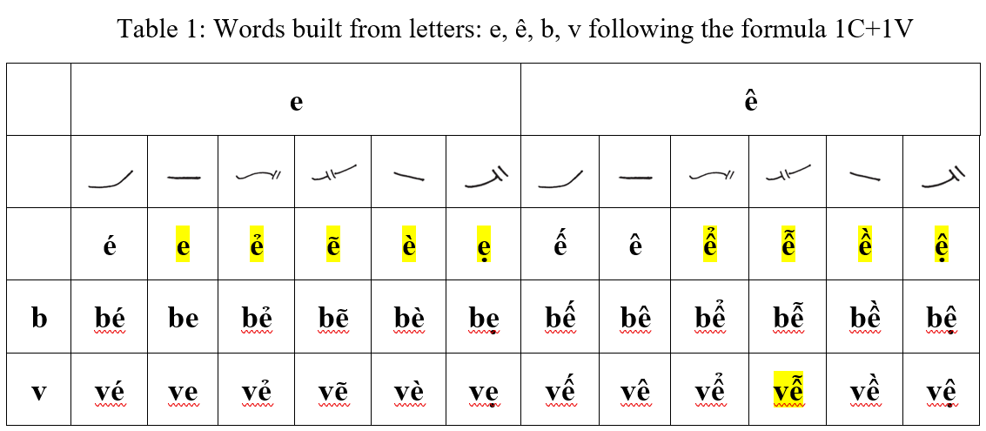

Click on the sound button to listen, then repeat.
Try to practice pronouncing each word following the spelling proces
The highlighted words (i.e., vễ) do not have meaning or go with other word to create meaning.

Slide 18
4. Reading
Let’s challenge yourself with these long words and sentences.
Try to pronounce one single word (using spelling process in 3.2) at one time and then try to read aloud the whole sentence. Click the sound button near the box for the pronunciation!
ve ve
bè bè
bế bé
bé vẽ bê
be be
be bé

